Slide 1
CU Toolkit – Introduction
What You Need to Know to Understand TIMS

Slide 2
What Does CU Toolkit Do?
Extends the capabilities of Synergy Toolkit.
Provides standard functionality for all programs.
Handles a variety of program types from simple to complex.

Slide 3
Methods
Provide standard behavior so the simple case does not require additional code.
Allow the program to extend the behavior of the standard model for the specific case.

Slide 4
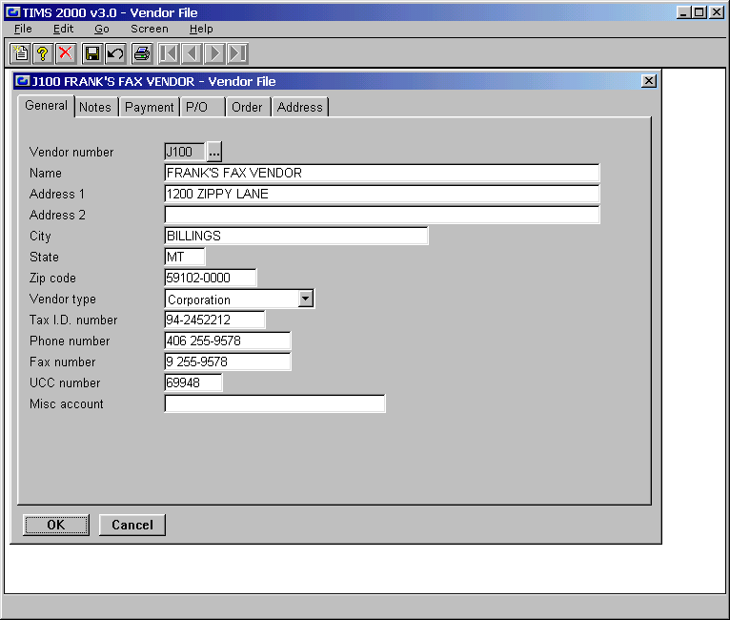
Synergy Toolkit Methods
Arrive method
Change method
Drill method
Leave method

Slide 5
Input Methods
Menu method
Arrive method
Display method
Tab method
Leave method

Slide 6
Program Methods
Menu Method
Save Method
Data Method
Validate Method

Slide 7
Input Detail
CUE_PROCESS
Arrive Method
Display Method
I_INPUT
Arrive Method
Leave Method
Change Method
Menu Method
Display Method
Leave Method

Slide 8
Method Map
Menu Method
Save Method
Menu method
Arrive method
Data Method
Method Key
Arrive method
Field
Change method
Input
Drill method
Leave method
Program
Display method
Tab method
Leave method
Validate Method

Slide 9
Program Control (progctl)
A structure holding information which describes the current program state.
Passed between subroutines.

Slide 10
Program Control
inputctl
Arivmeth arivstat
Dispmeth dispstat
Leavmeth leavstat
Menumeth
Tabmeth
Inpid
Listid
Dataobjidx
Privcontrol
Flowcontrol
Mesgcontrol
Ctltype
Lrequest
Col_hotkey
Ctlname
Col_signal
Progctl
Pappname
Numscreens
Savemeth
Datameth
Menumeth
Keydrillmeth
Filtermeth
Validmeth
Tb_id
Tabid
Drillcontext
Inpcol_id
Scrcol_id
Curscreen
Privcontrol
Flowcontrol
Progtype
hinputctl
hparent
hchildctl
hdataobjtbl
dataobjtbl
hcurdataobj
horgdataobj

Slide 11
Program Control Properties & Methods
Application name
Number of screens
Mode - add, change, delete, etc.
Type of program
Pointers to related structures (hinputctl)
Save method
Data method

Slide 12
Program Control Methods
Save method:
Deals with Add, Change, Delete.
Does nothing if data did not change.
Data method:
Locates record(s) matching current user entry.
Navigates pre-filtered selections.

Slide 13
Input Control (inputctl)
A structure holding information which describes a single input screen.
Passed between subroutines via the Program Control.

Slide 14
Input Control Properties & Methods
Control name
Input ID
Screen flow
Display, reset, validate
Arrive method
Display method
Leave method

Slide 15
Data Object Table (dataobjtbl)
A structure holding current and original copies of the data record.
Used by program control and input control:
They can be the same table or different ones.

